Slide 1
Smart Caching Strategy for IoT Networks using Deep Reinforcement Learning

Slide 2
INTRODUCTION
Caching is a networking technique that enables networking nodes to store frequently requested files, mitigating network traffic and improving the response time.
Edge caching is a new technology that enables edge nodes to be a part of the caching schemes and store files. Being close to the end-users means that the request does not necessarily go all the way up to the source to fetch the response because one of the edge nodes might already have the desired file in its caching memory and is ready to fulfil the request
With the increasing number of users and data in the world and the ever-increasing demand for more reliable and faster connections, it becomes very important to make this caching policy intelligent and be able to make decisions on its own.

Slide 3
Problem Statement
Aim to create an optimal policy for caching files in an IoT network scenario based on the different attributes related to the files that affect the caching policy.

Slide 4
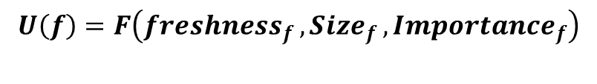
Utility of a file
We define the utility of a file as a quantitative measure of the usefulness it provides.
Upon extensive research we find that the utility of the file must depend on the following factors.
Type of the file
Size
Freshness
$$U\left(f\right)=F\left(freshness_{f }, Size_{f }, Importance_{f}\right)$$

Slide 5
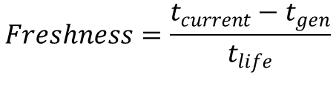
Contd.
Freshness of the file defines numerically how new/fresh the file is.
The freshness of a file is given as:
Where t_{current} is the current time step, t_{gen} is the time the file is generated and t_{life} is the lifetime of the file.
$$Freshness=\frac{t_{current}−t_{gen}}{t_{life}}$$

Slide 6
Limitation of existing work
Almost in all the work done so far, none of them considers the size of the cached file as a factor.
In a real-world scenario, it is more practical for the files to have different sizes.

Slide 7
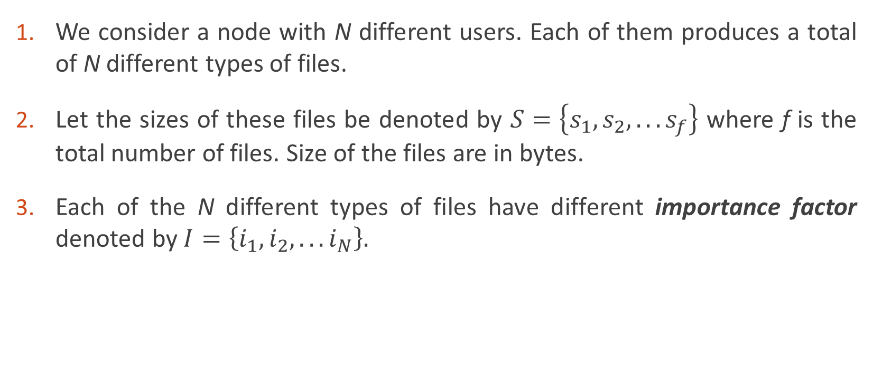
System Model
We consider a node with N different users. Each of them produces a total of N different types of files.
Let the sizes of these files be denoted by $S=\left\{s_{1},s_{2},. . . s_{f}\right\}$ where f is the total number of files. Size of the files are in bytes.
Each of the N different types of files have different importance factor denoted by $I=\left\{i_{1},i_{2},. . . i_{N}\right\}.$

Slide 8
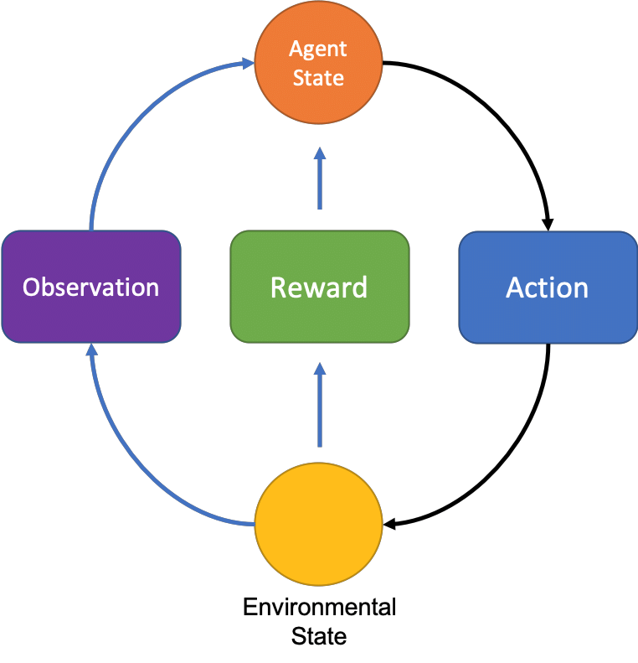
Reinforcement Learning

Slide 9
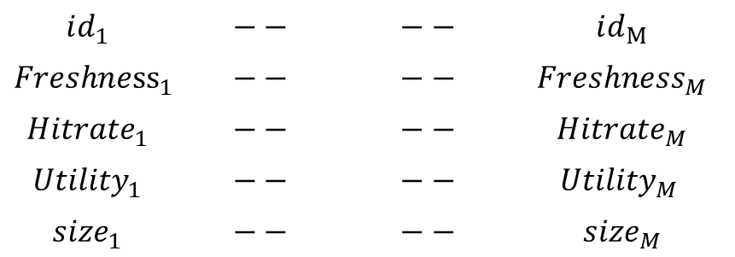

STATES
In order to form our observations we first define the memory status of the caching node
$$id_{1}$$ | $$−−$$ | $$−−$$ | $$id_{M}$$
$$Freshne{ss}_{1}$$ | $$−−$$ | $$−−$$ | $$Freshne{ss}_{M}$$
$$Hitrate_{1}$$ | $$−−$$ | $$−−$$ | $$Hitrate_{M}$$
$$Utility_{1}$$ | $$−−$$ | $$−−$$ | $$Utility_{M }$$
$$size_{1}$$ | $$−−$$ | $$−−$$ | $$size_{M}$$
$$MemStatus=$$
The requested file, its lifetime and its size are also made part of the observation by putting them in a single variable $ReqVar=\left[id, lifetime, size\right]$

Slide 10
ACTIONS
There are only two possible actions, either to cache the file or to not cache the file.
The action space is hence A = {0, 1}.
0 denotes to not cache the file whereas 1 denotes to cache the file.

Slide 11
Reward
We define our rewards based on different actions our agent takes.

Slide 12

When action is 1
$$R=n_{i}×\{max\left(\left(x, G_{t}−G_{\left\{t−1\right\}}\right)\right)−c_{1}×size_{i}\}$$
Where n_{i} is the number of times the files is requested and c₁ is a constant whose value can be adjusted.
x is the cap on the negative side of the change in utility.
We define the utility of the cache as the sum of the utilities of all the files present in the cache.
$$G_{t}=\sum_{1}^{m}{U(x_{i})}$$

Slide 13


When action is 0 and the file is present in the cache
$$R=n_{i}×c_{2}$$
Where n_{i} is the number of times the files is requested and c₂ is a constant denoting that this is a good action
When action is 0 and the file is NOT present in the cache
$$R=n_{i}×c_{3}$$
Where n_{i} is the number of times the files is requested and c₃ is a constant denoting that this is a bad action

Slide 14
Evaluation Metrics
HIT RATE
VALUE COLLECTED
Hit rate is the rate at which the users’ requests are fulfilled locally by the caching nodes .
Value collected is the accumulation of utility over time by hitting a file in the cache

Slide 15
Results and Discussion

Slide 16
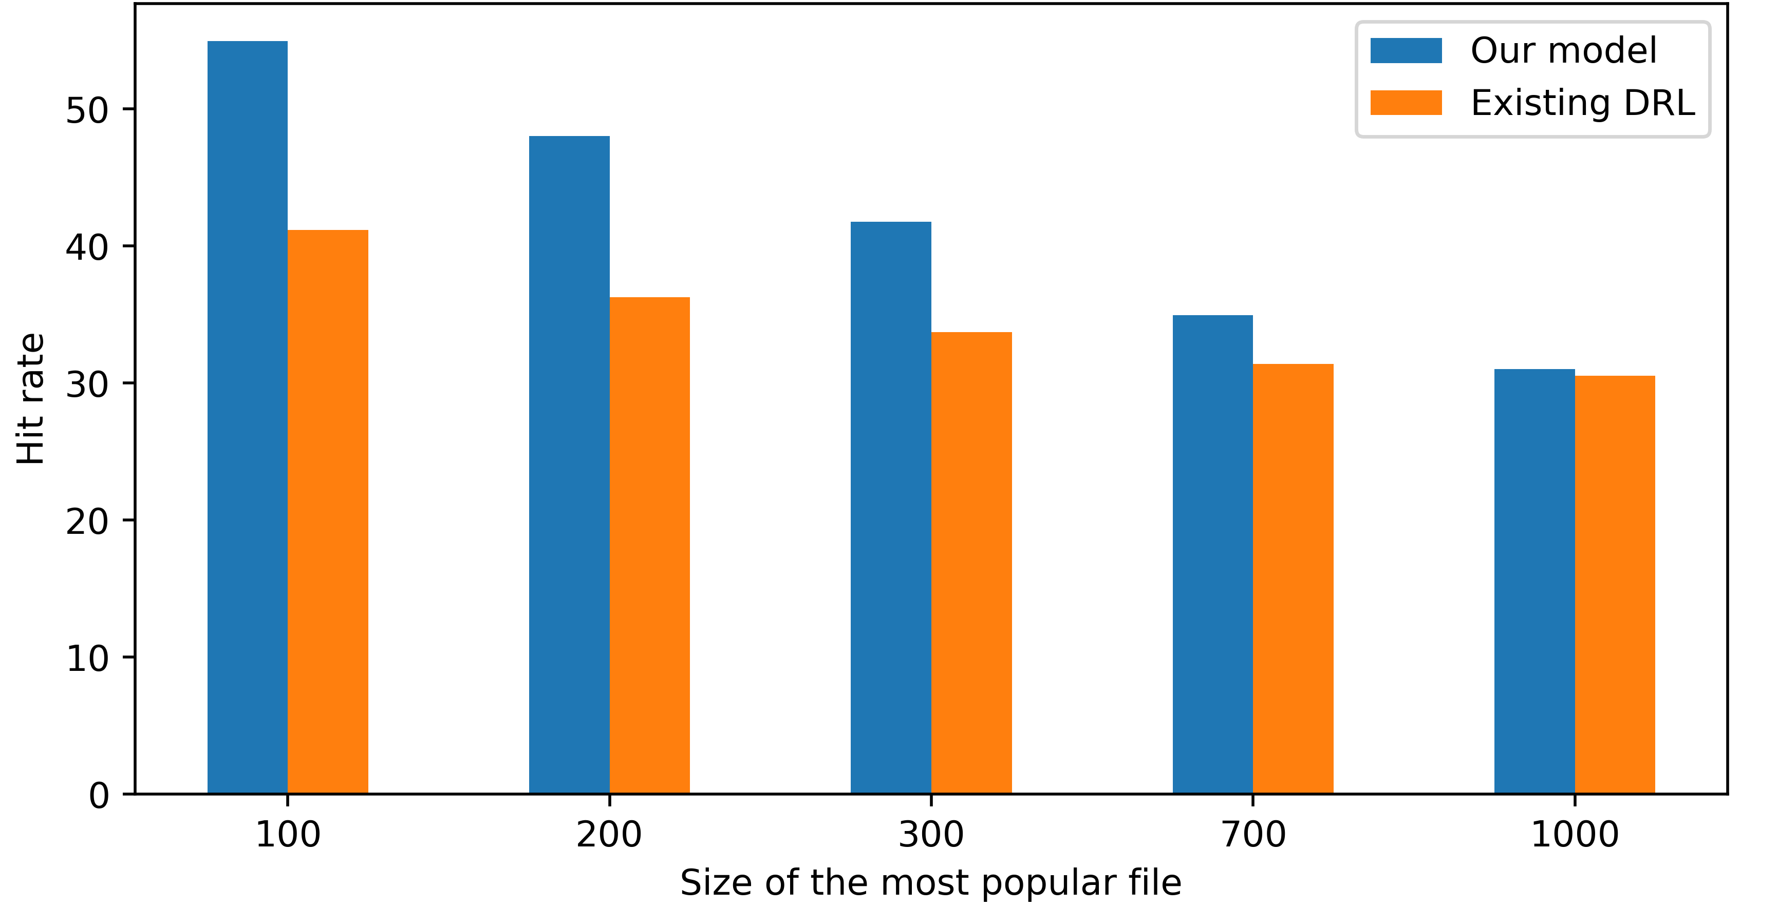
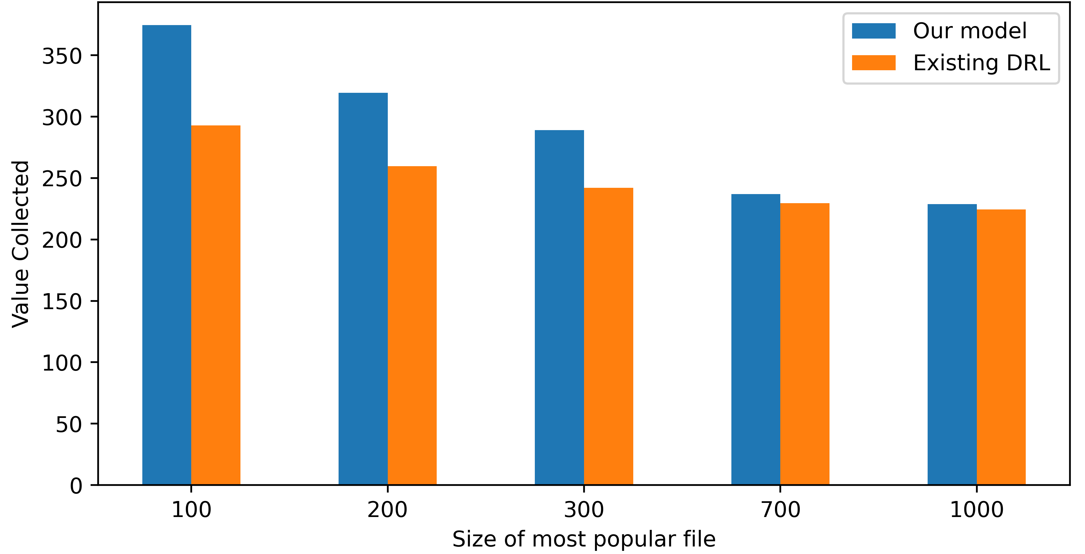
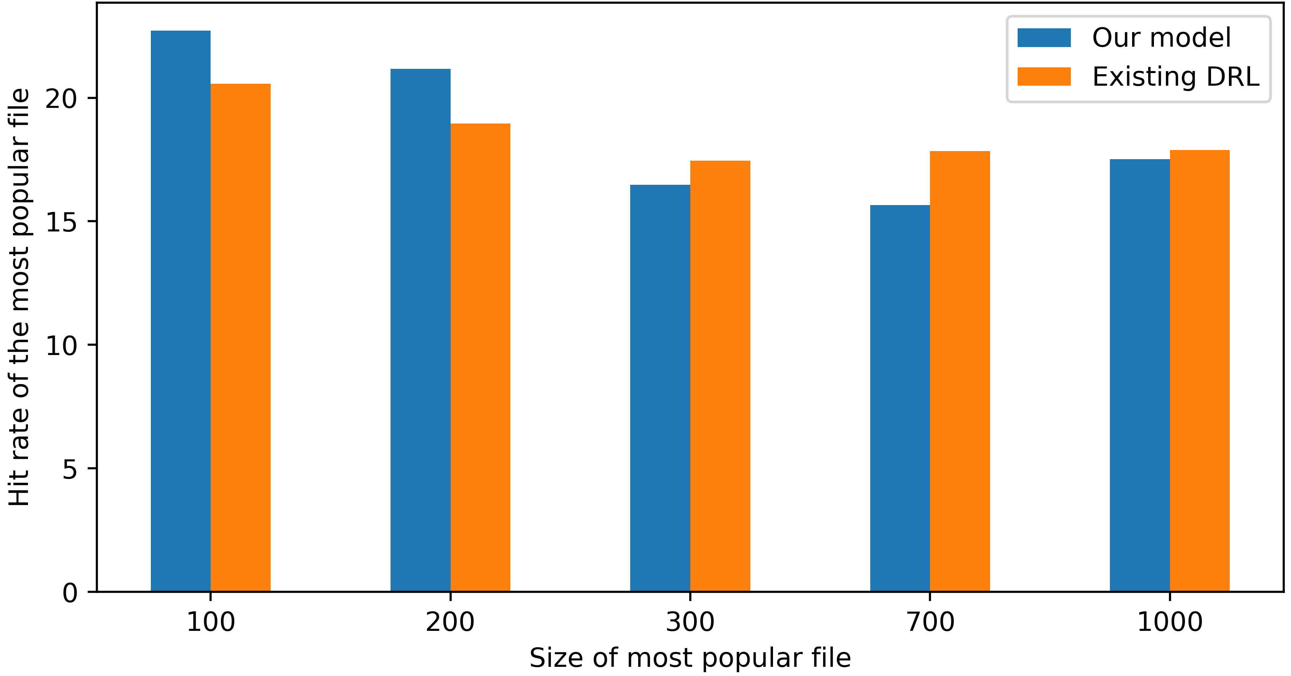
1) Changing size of the most popular file
a) Average Hit rate
c) Value Collected
b) Average hit rate of the most popular file

Slide 17
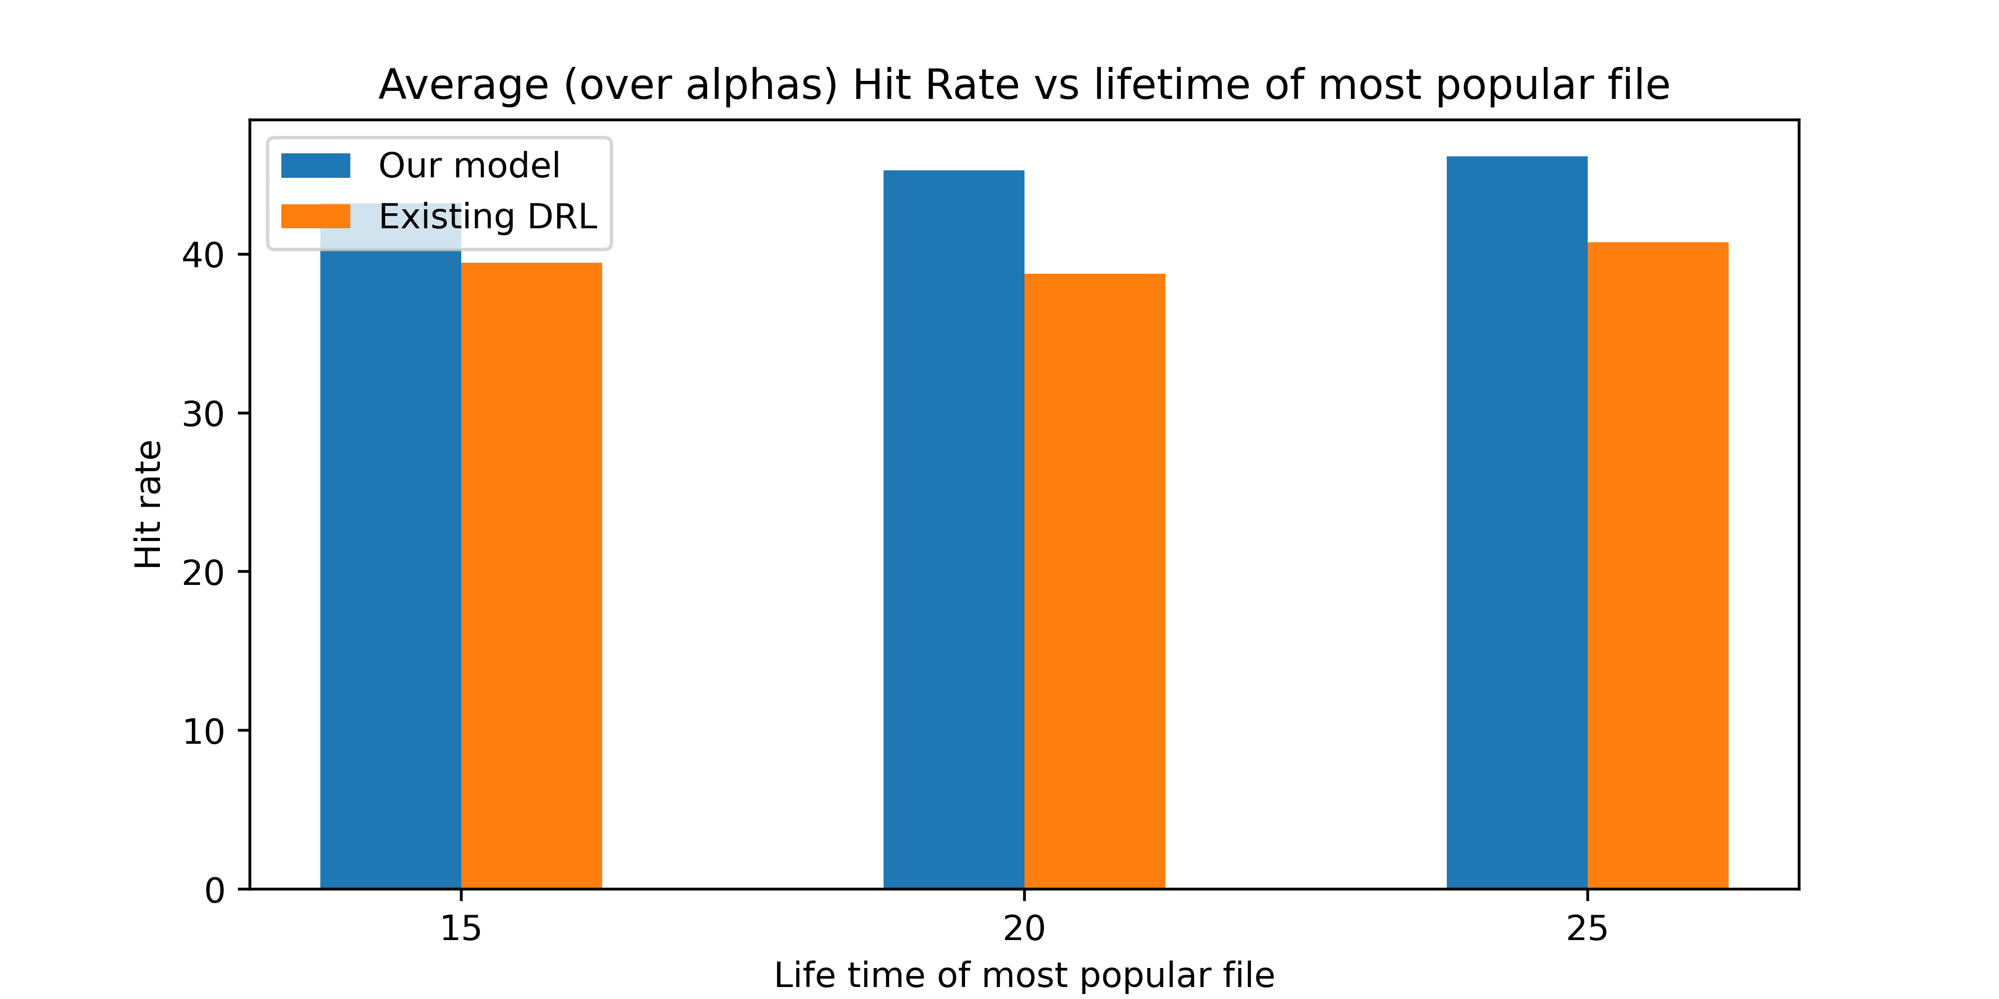
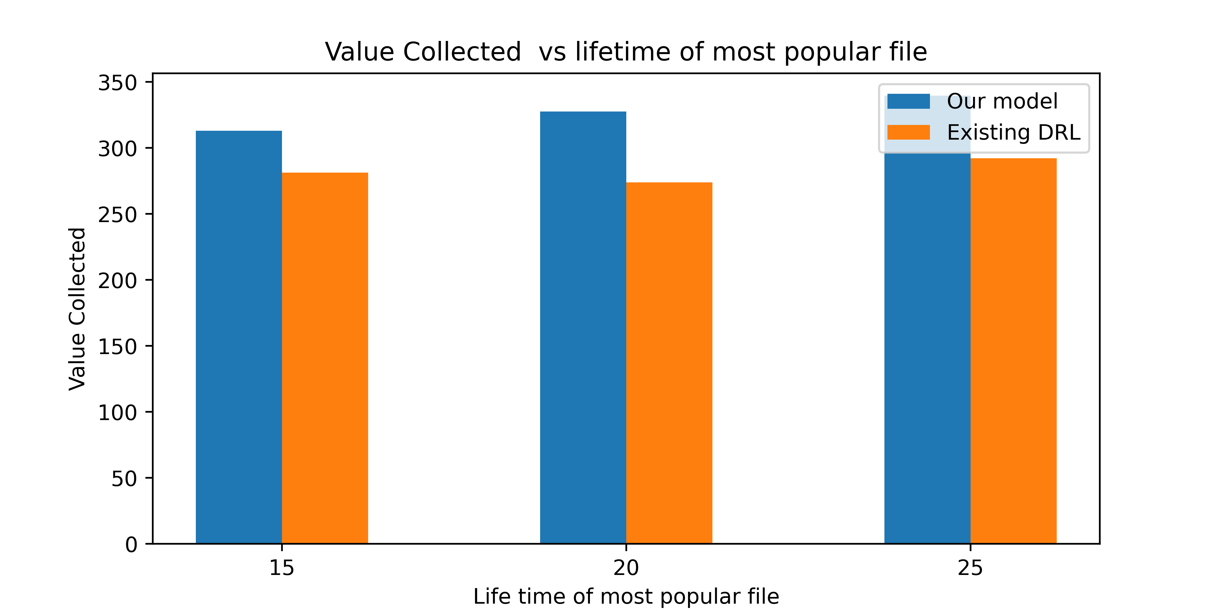
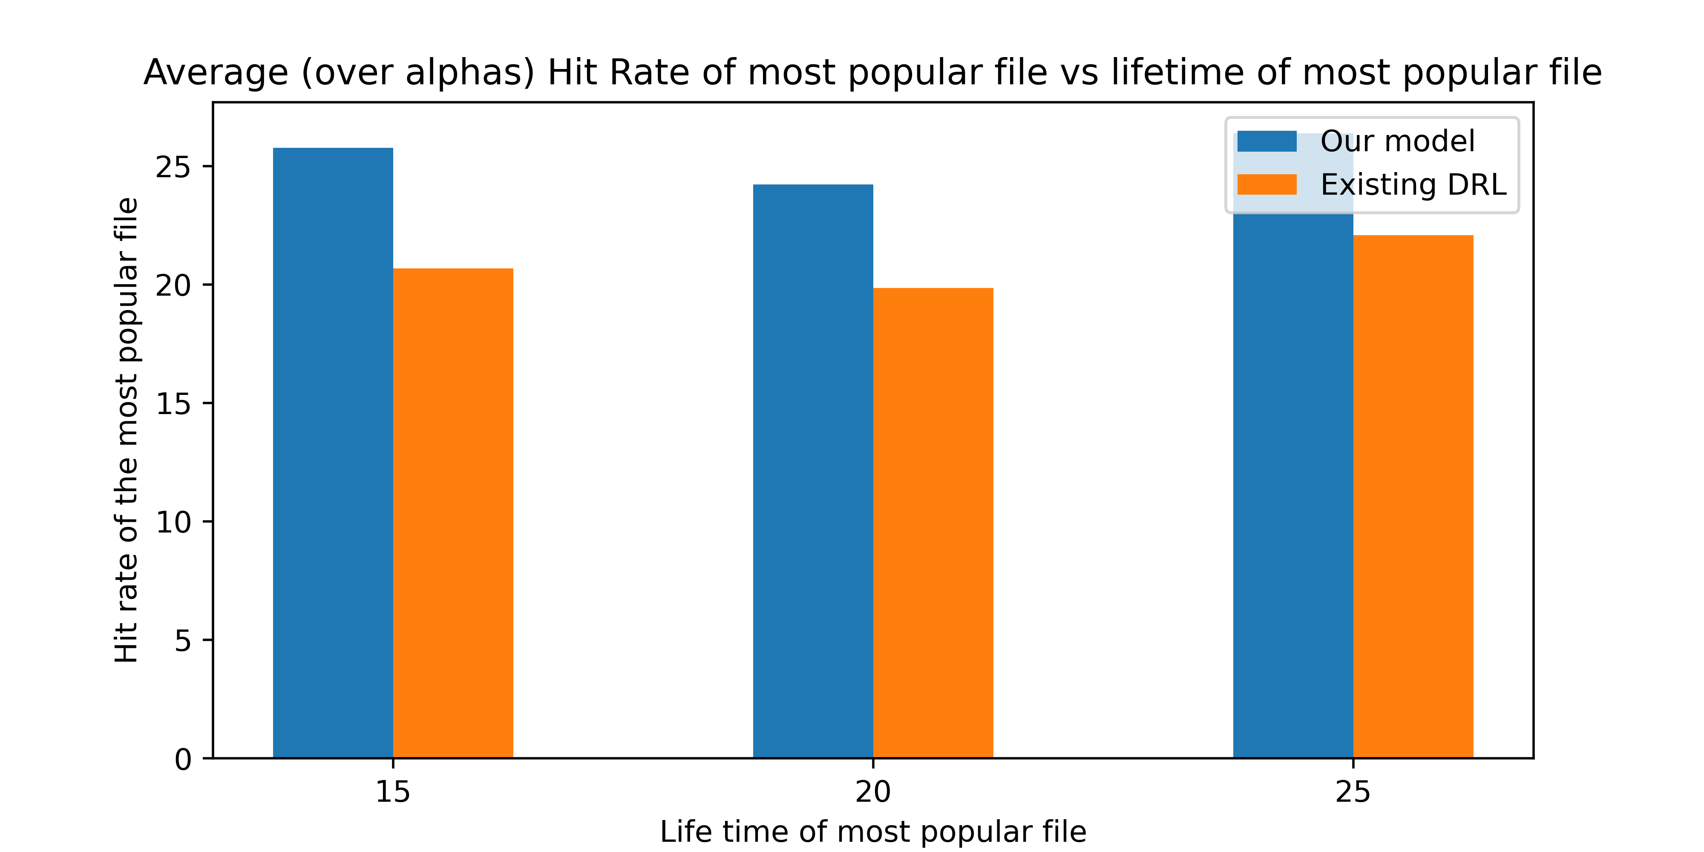
2) Changing lifetime of the most popular file
a) Average Hit rate
c) Value Collected
b) Average hit rate of the most popular file

Slide 18
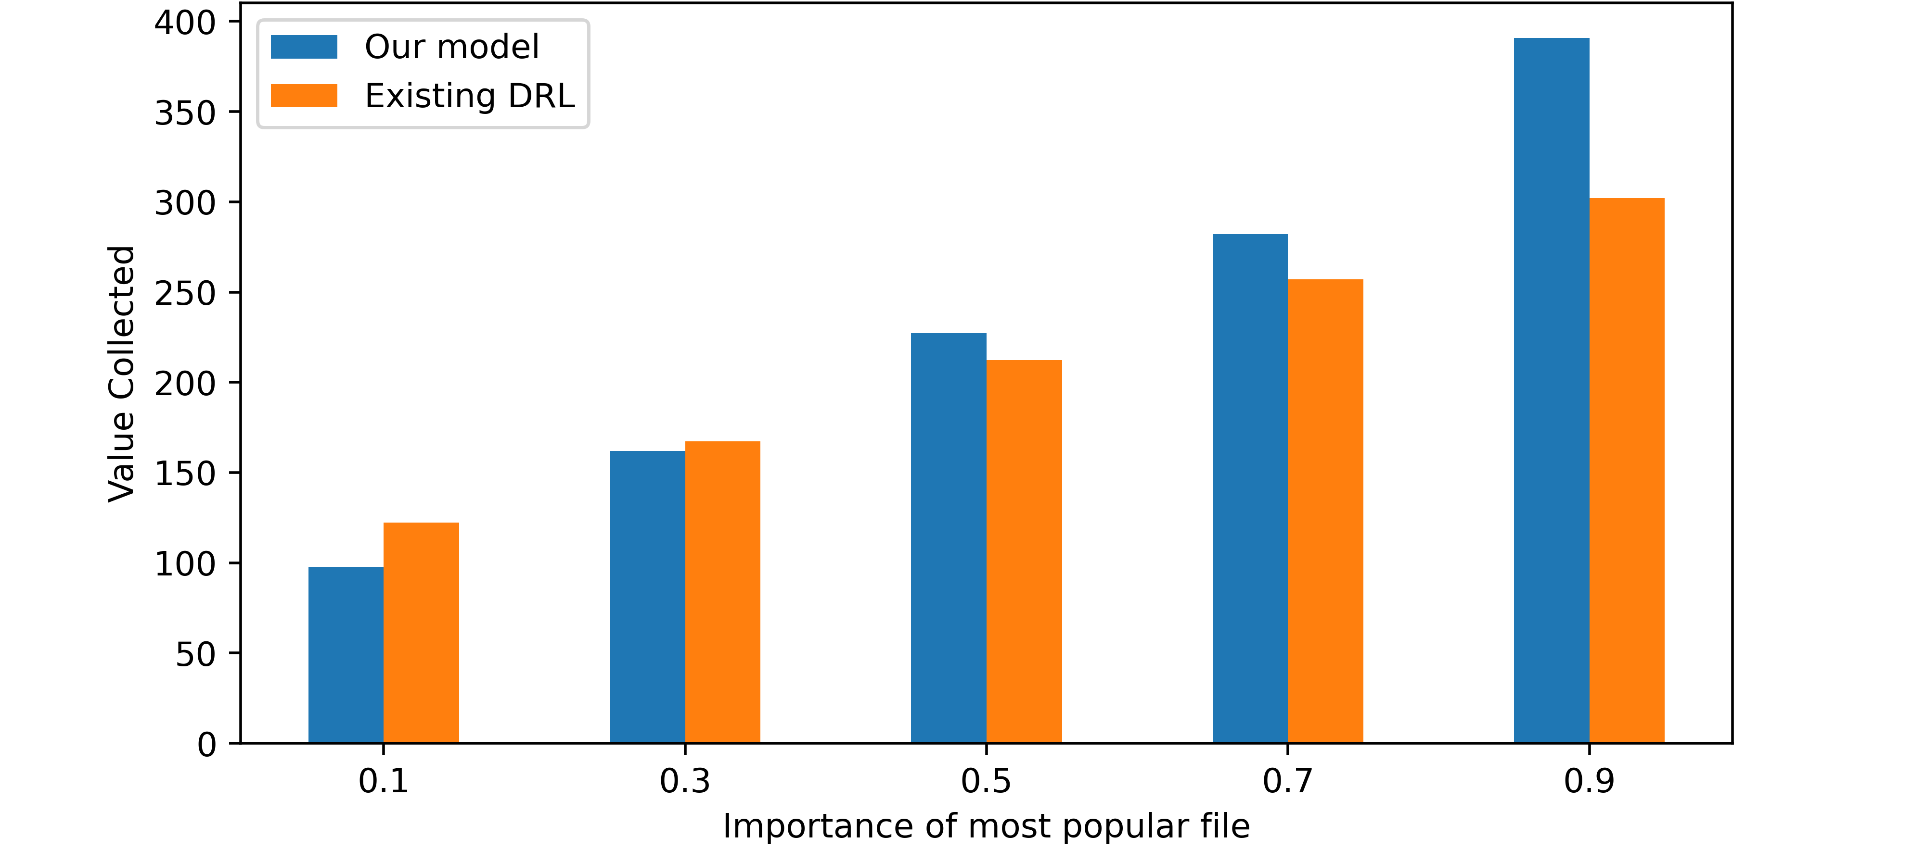
3) Changing importance of the most popular file
a) Value Collected

Slide 19
Conclusion
We develop a caching policy using Deep Reinforcement Learning.
We evaluate and compare our method with existing DRL solution, under different setting.

